Slide 1
A review of population, education and unemployment in AL, AZ and AR from 2013-2017
Aprajita Srivastava

Slide 2
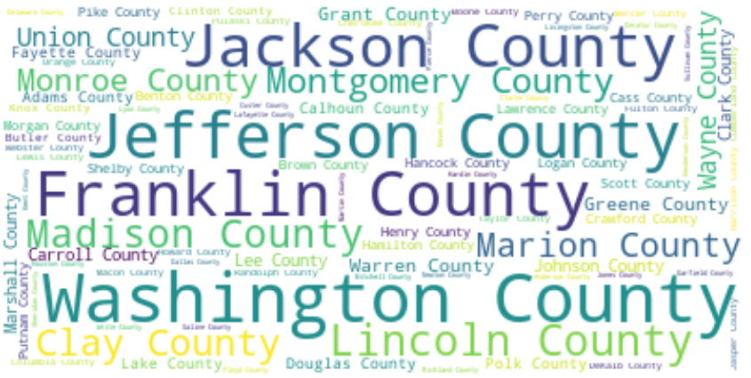
First I looked at the most popular county names in US. Did it have any co-relation to population or education? A quick glance at the data did not show any co-relation.
The journey…

Slide 3
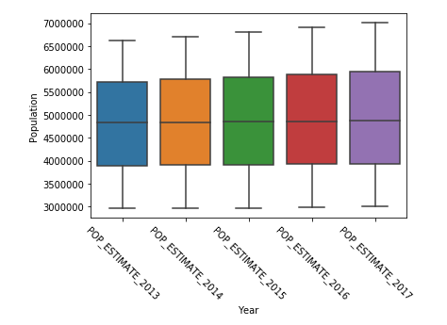
The journey
Then I looked at the data for three different states - AL, AZ and AR over a 5-year period (2013-2017).
They had an average population of 3.0M to 5.0M from 2013-2017. The average population seemed to be consistent – No alarming changes

Slide 4
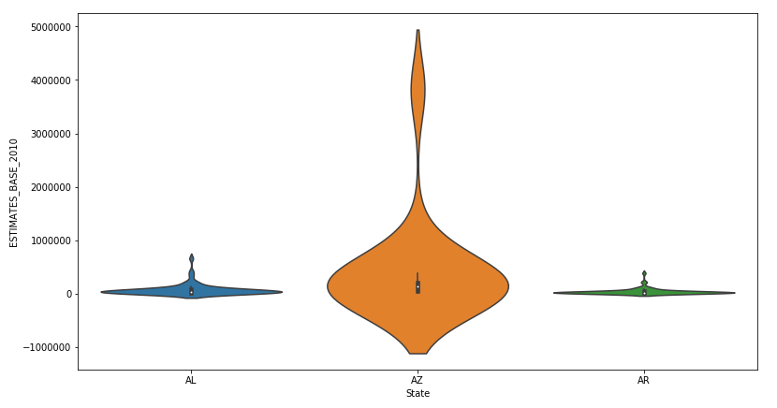
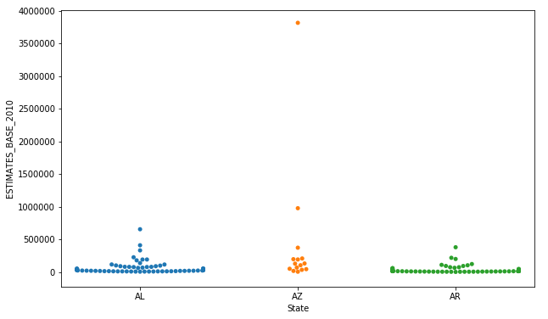
Then I looked at a sample data for population distribution for all counties in AL, AZ, and AR I realized that the violin plot was not relevant so I did a scatter plot. It looks like most of the counties have similar population. There is one county in AZ that is an outlier.
The journey

Slide 5
Cleaning data
I had 3 sets of data and they were not in the same format. The population and unemployment were provided on a yearly basis. However, education data was available in 5-year block. I converted the population and unemployment data to match the data for education.
I plotted the data to visualize the rate of unemployment when compared to education level.

Slide 6
View of overall population and people with BA/BA degree (2013-2017)

Slide 7
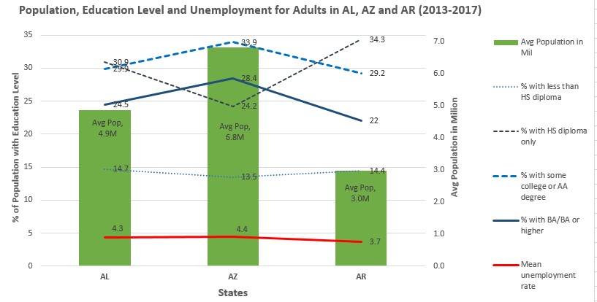
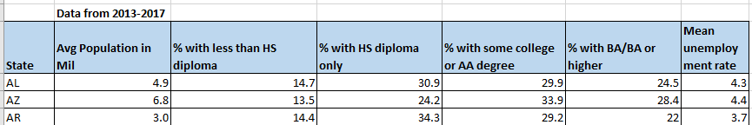
Mean unemployment compared with education in AL, AZ, and AR

Slide 8
Conclusion
The rate of unemployment appears to –
Closer trend to % of population with some college education or AA or people with BA/BS. It actually seems to follows a better trend of % with less than HS education
The data related to unemployment does not include the number or % of people who are unemployed and their education level. We only know the total unemployment for the overall population so it is hard to conclude anything definitively

Slide 9
Data Source
USDA – employment, population and education data at -
https://www.ers.usda.gov/data-products/county-level-data-sets/download-data/

